Slide 1



















Competitors
Major Competitors
Limited Competitors

Slide 2
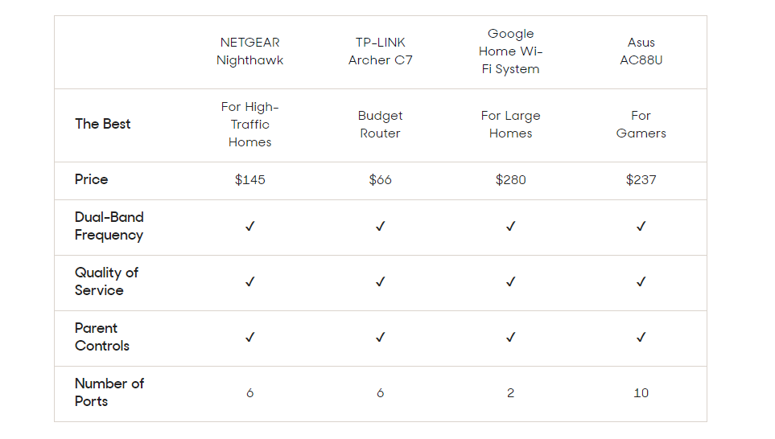
Customer Reviews – Wireless Routers
Source - https://www.reviews.com/best-wireless-router/

Slide 3
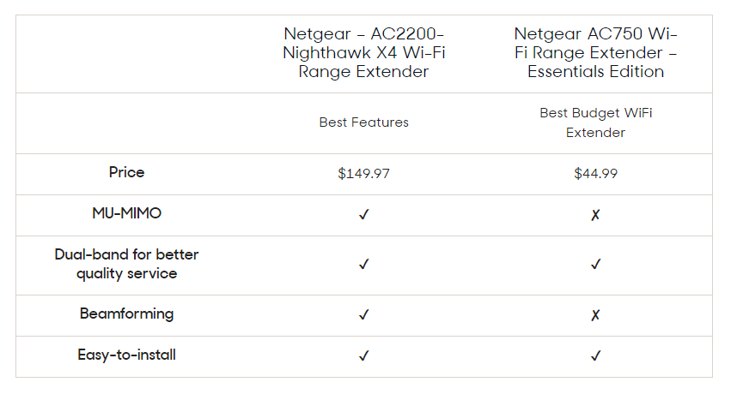
Customer Reviews – WiFi Extenders
Source - https://www.reviews.com/best-wireless-router/

Slide 4
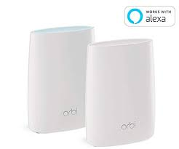
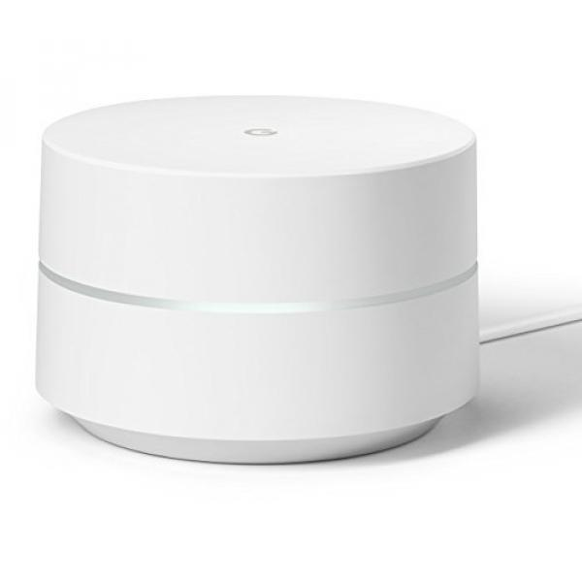
Mesh WiFi Router Systems
Orbi RBK50
Google WiFi

Slide 5
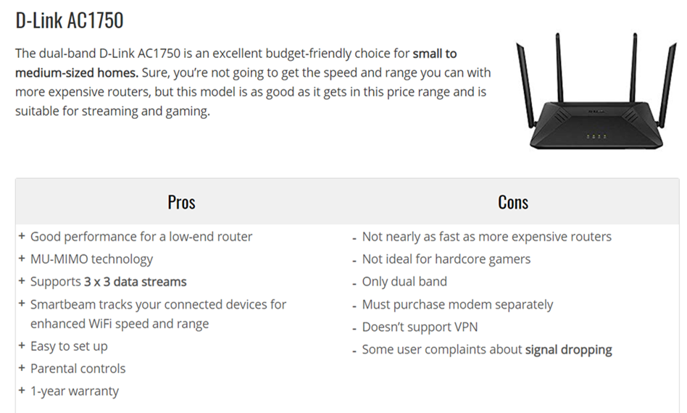
Budget Routers Under $100

Slide 6
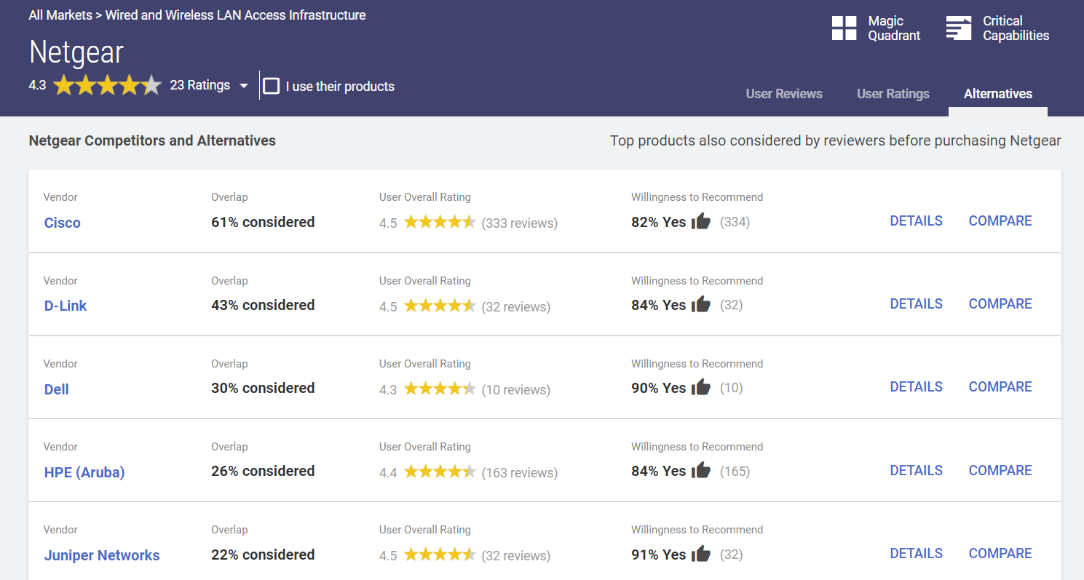
Competitors

